Slide 1


SQL Test _ Data Catalog
Kelvin Okuda
12/12/2021
by Uber

Slide 2

Cornershop operates in more than 20 cities, reaching tens of thousands of orders per day. One of main missions as a Catalog Team is to provide to our customers the best experience possible, making sure they see all the important information on the app and get delivered all they asked for, even not having direct contact with them!
In this case, we ask you to help us with our daily operation regarding some of the KPIs we use to do so.
Here are the details of the info we will provide to you:
(A) orders table
. order_id: identifier of the order
. status: status of the order (ongoing, delivered, canceled)
. created_dow: day of the week of the creation date of the order (0: Sunday, 6: Saturday)
. created_time: hour in which the order was created
. updated_dow: day of the week the order was last updated (0: Sunday, 6: Saturday)
. updated_time: hour in which the order was last updated
. delivered_dow: day of the week of the delivery date of the order (0: Sunday, 6: Saturday)
. delivered_time: hour in which the order was delivered to the customer
. picker_id: identifier of the shopper that made the picking of the order
. driver_id: identifier of the shopper that made the delivery of the order
. storebranch_id: identifier of the store branch in which the order was purchased
(B) orders_product table
. order_id: identifier of the order
. product_id: identifier of the product
. quantity: quantity of the product requested by the customer
. quantity_found: quantity found of the product by the shopper
. unit_price: price per unit bought
(C) store_branch table
. storebranch_id: identifier of the store branch
. store: identifier of the store in which the branch belongs to
. city: city in which the branch is located
(D) shoppers table
. shopper_id: identifier of the shopper
. seniority: level of shopper's experience
. found_rate: historic percentage of the products that the shopper found
. picking _speed: historic velocity of the shopper's picking of products, in minutes per product
. accepted_rate: historic percentage of orders accepted by the shopper
. rating: historic customer's evaluation/rating of the shopper

Slide 3
The goal is to answer the following questions regarding our operation. You must use SQL queries and plot the output of the SQL queries of the questions 1 to 6 using a graphic tool (ex.: Excel, Tableau, PowerBI).
As deliverable files, we will ask you for a .sql file with the queries used and a short management report explaining your main conclusions (use the graphics to support your conclusions and make sure they are included in the report).
Questions:
(1) Calculate the number of orders per day of the week, distinguishing their status
(2) Calculate the cancelation rate grouped by each store
(3) Calculate the average found rate(*) of the orders grouped by store and city
(4) Determine top 3 selling products_ids in total volume delivered to customer
(5) Calculate the % of delivered orders that were created and delivered in different days, grouped by hour of creation
(6) Calculate how many products there are in each partition of the ABC Sales Curve(**) grouped by store
(7) Calculate the % of delivered orders in which the picker_id and driver_id are different
(*) Found Rate: ratio between the amount of product ids the customer requested (regardless of how much of each product was requested) and the quantity of product ids the shopper found (again, regardless of the how much of each product was found)
(**) ABC Sales Curve: curve that classifies products in value sold, where A curve represents 80% of the total sales value, B curve 15% and C curve 5%

Slide 4
Observations:
I choose to use WAMP as the web development environment in order to create a MySQL database alongside dBeaver as the SQL client and Microsoft Power BI as the data visualization tool.
Some data modelling has been made on MySQL and Google Sheets. The others have been done on power query.

Slide 5
Insights & Results

Slide 6
.Insights
R$ 1.553.860
6,955
R$ 226,57
Total amount of products ordered (regardless the order status)
Orders made.
5,466 were completed and other 1,174 were still pending.
Average amount spent per order
4,53%
0%
R$ 65.790
Cancelation rate of orders.
It peaks on Wednesdays and Thursdays.
Cancelation rate of orders when the creation of the order is the same as the delivery date, meaning that this delay is one of the key factors for cancellations.
Is the total amount of orders that were cancelled.

Slide 7
.Insights
R$ 10,00
17,526
96%
Average price of the products
Different products were sold and delivered to customers
Considering the top 100 products by ordering volume, the price is inferior than R$ 10,00 for 96% of them
R$599,90
19,060
Price range, defined by the cheapest product (R$0,09) and the most expensive (R$ 599,99)
Number of products that found quantity was below the quantity required in the order

Slide 8
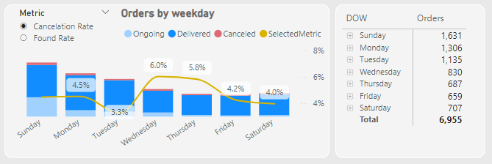
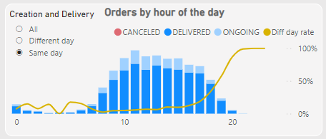
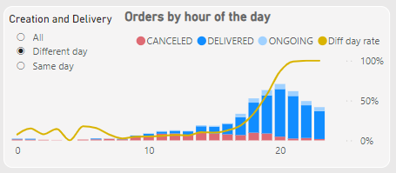
.Insights
Sunday is the prefered day to order, but not to get delivered effectively. People order from 8am to 6pm.
About 79% of all orders are made with the expectation to have it delivered in the same day. Those orders are concentrated between 6am and 6pm.
Sunday, Monday and Tuesday are the days that concentrates nearly 60% of all orders. The other 40% are distributed almost evenly by the rest of the week.
However, about 21% of the orders are place late during the day, from 7pm till midnight. Then, many of them will lead to cancellations, probably due to out of stock items.

Slide 9
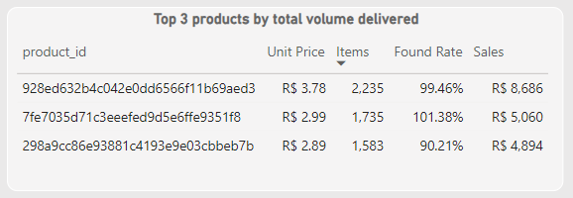
.Insights
Between R$3,00 and R$4,00 is the number that drags converts higher.
Looking at the chart below is easy to see a direct relationship between the quantity of products and its total amount, which is something around 3,5x. Those 3 products have a very similar unit price that seems to be an attractive price for customers.

Slide 10
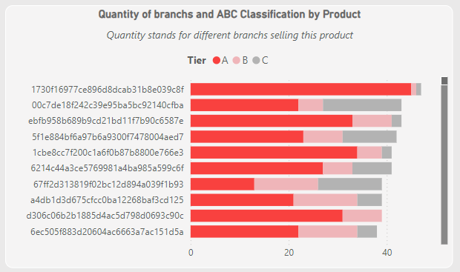
.Insights
Some of them are true champions, some are not quite.
Looking at the top sold products, we can see some inconsistency. The top one is a real champion: he figures in the A tier for the big majority of the stores. However, the second one is a mix of good and disappointing sales performance.
The same situation happens many other times, with many products. It is necessary to explore more, in detail, in order to understand why this has been occurring.

Slide 11
Data exploration through SQL

Slide 12
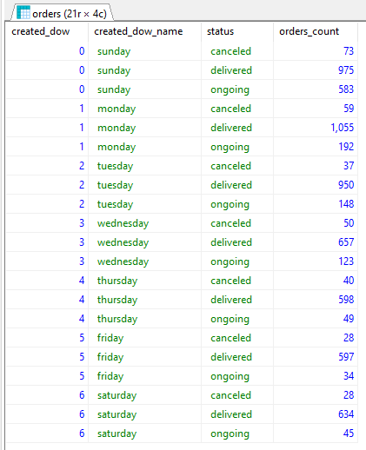
(1) Calculate the number of orders per day of the week, distinguishing their status
SELECT
ord.created_dow,
(case created_dow
when 0 then 'sunday'
when 1 then 'monday'
when 2 then 'tuesday'
when 3 then 'wednesday'
when 4 then 'thursday'
when 5 then 'friday'
when 6 then 'saturday'
END) created_dow_name,
lower(ord.status) status,
COUNT(*) count
FROM teste_sql.orders ord
GROUP BY ord.created_dow, ord.status

Slide 13
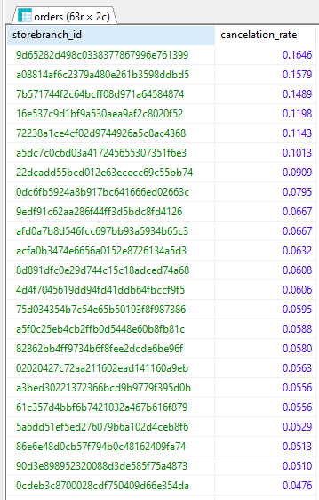
(2) Calculate the cancelation rate grouped by each store
SELECT
ord.storebranch_id,
sum(case when ORD.status = 'CANCELED' then 1 else 0 end)/COUNT(*) "cancelation_rate"
FROM teste_sql.orders ORD
GROUP BY ord.storebranch_id
ORDER BY sum(case when ORD.status = 'CANCELED' then 1 else 0 end)/COUNT(*) desc
Note: there are more items in the list

Slide 14
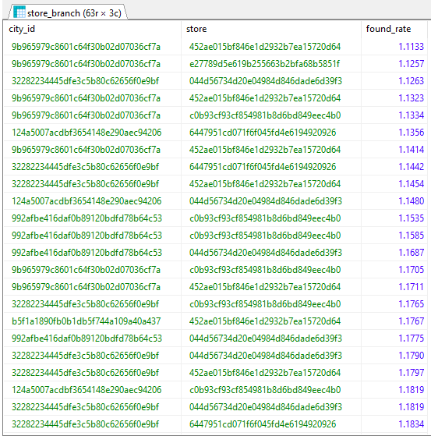
(3) Calculate the average found rate(*) of the orders grouped by store and city
SELECT
strb.city_id,
strb.store,
(SUM(ordp.quantity) / SUM(ordp.quantity_found)) "found_rate"
FROM teste_sql.orders ord
left outer join teste_sql.orders_product ordp ON (ORD.order_id = ordp.order_id)
LEFT OUTER JOIN teste_sql.store_branch strb ON (ORD.storebranch_id = strb.storebranch_id)
GROUP BY ORD.storebranch_id, strb.city_id
Note: there are more items in the list

Slide 15
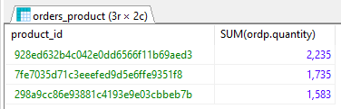
(4) Determine top 3 selling products_ids in total volume delivered to customer
SELECT
ordp.product_id,
SUM(ordp.quantity) "count"
FROM teste_sql.orders_product ordp
left outer join teste_sql.orders ord ON (ordp.order_id = ord.order_id)
LEFT OUTER JOIN teste_sql.store_branch strb ON (ORD.storebranch_id = strb.storebranch_id)
WHERE ORD.`status` = 'DELIVERED'
GROUP BY ordp.product_id
ORDER BY SUM(ordp.quantity) DESC
LIMIT 3

Slide 16
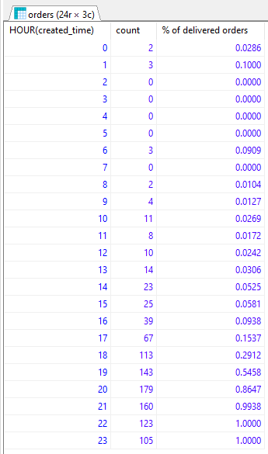
(5) Calculate the % of delivered orders that were created and delivered in different days, grouped by hour of creation
SELECT
HOUR(created_time),
sum(case when (ORD.created_dow <> ORD.delivered_dow) then 1 ELSE 0 END) "count",
sum(case when (ORD.created_dow <> ORD.delivered_dow) then 1 ELSE 0 END)/COUNT(*) "% of delivered orders"
FROM teste_sql.orders ORD
WHERE ORD.status = 'DELIVERED'
GROUP BY HOUR(created_time)

Slide 17

(7) Calculate the % of delivered orders in which the picker_id and driver_id are different
SELECT
sum(case when (ORD.picker_id <> ORD.driver_id) then 1 ELSE 0 END) "picker_dif_driver",
COUNT(*) "count",
sum(case when (ORD.picker_id <> ORD.driver_id) then 1 ELSE 0 END)/COUNT(*) "% of delivered orders"
FROM teste_sql.orders ORD
WHERE ORD.picker_id <> '' AND ORD.picker_id IS NOT NULL AND ORD.`status` = 'DELIVERED'

Slide 18
Power BI Dashboard
Q1~Q7 + shoppers

Slide 19
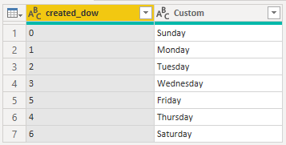
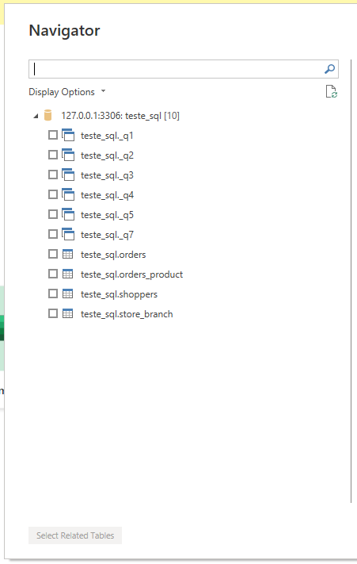
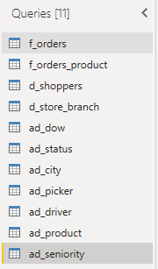
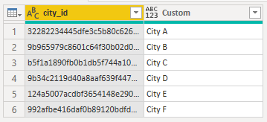
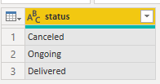
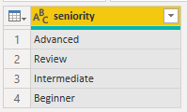
First, MySQL data source connection is established.
Then, the 4 tables is loaded to Power BI.
The second step is to classify the tables according to its function:
Fact
Dimension
Auxiliar dimension (all created from the facts and dimensions)
Auxiliar dimensions such as:

Slide 20
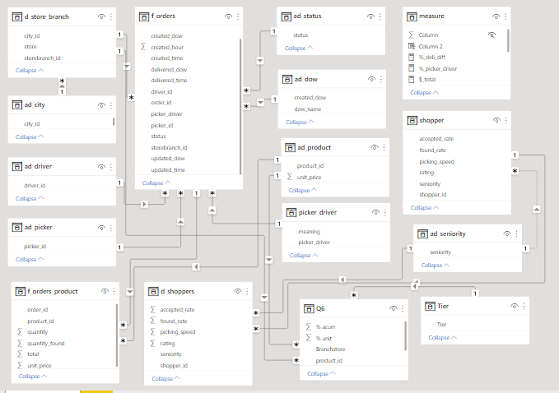
Relationship between tables

Slide 21
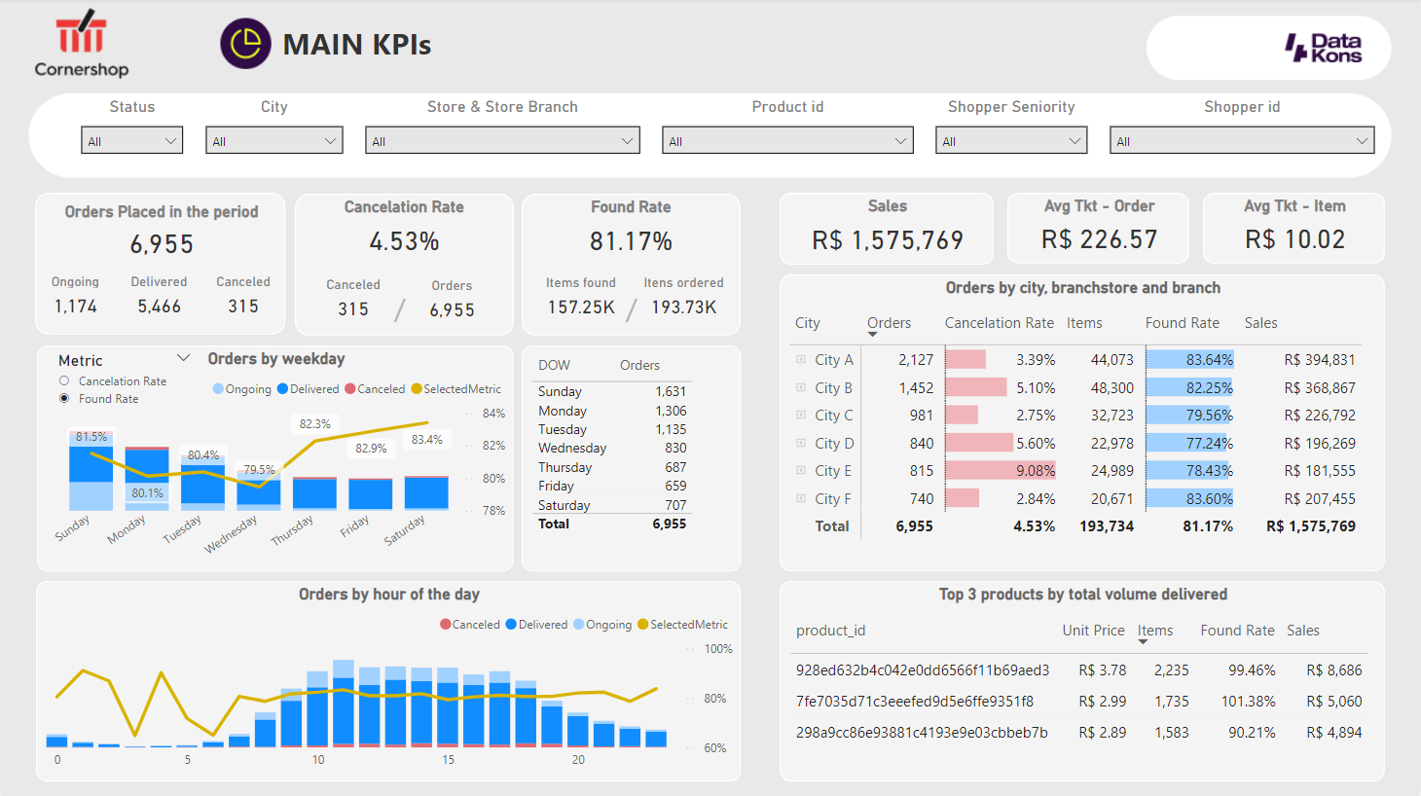
Sales dashboard - KPI view

Slide 22
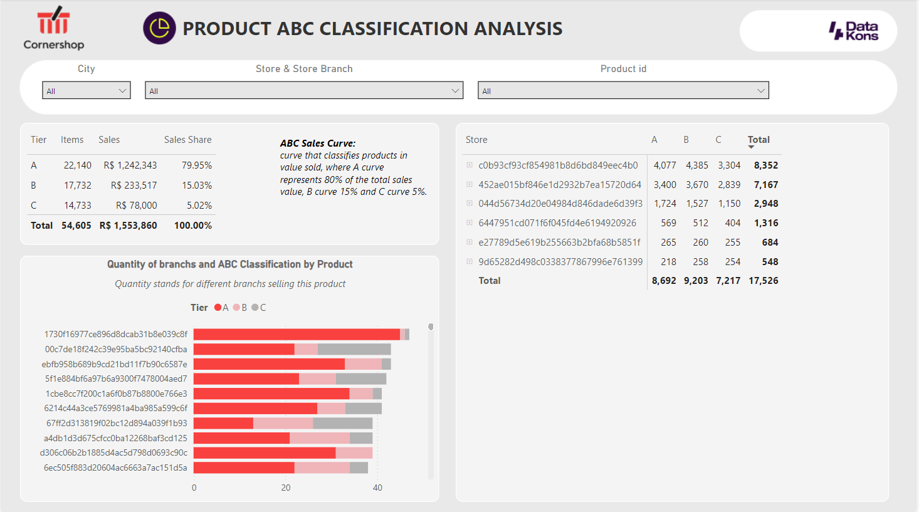
Sales dashboard - ABC classification view

Slide 23
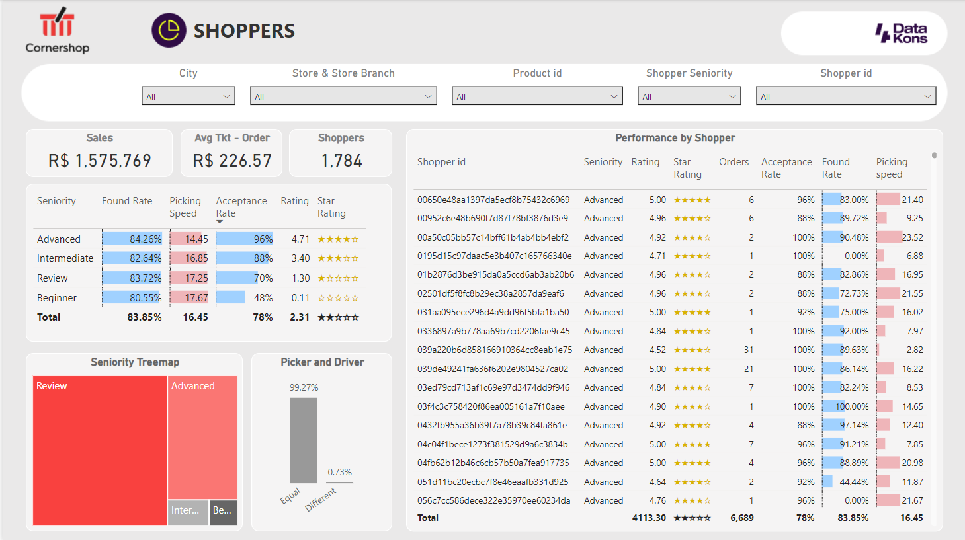
Sales dashboard - Shoppers view

Slide 24
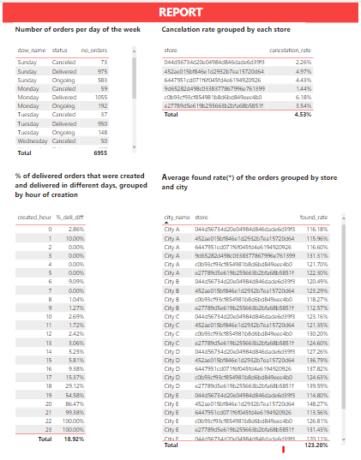
Sales dashboard - Report view

Slide 25
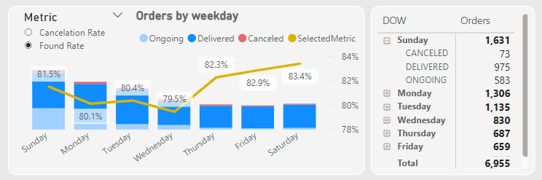
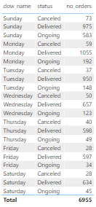
(1) Calculate the number of orders per day of the week, distinguishing their status
On dashboard
On report page

Slide 26
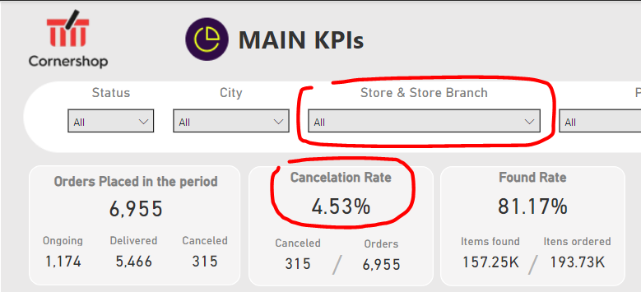
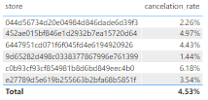
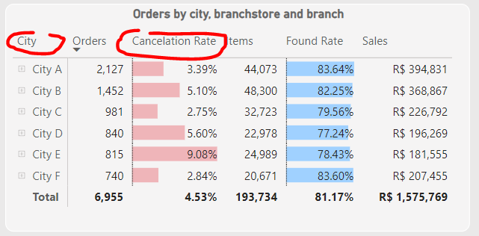
(2) Calculate the cancelation rate grouped by each store
On dashboard
On report page

Slide 27
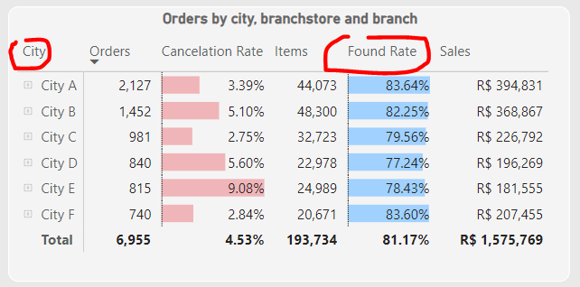
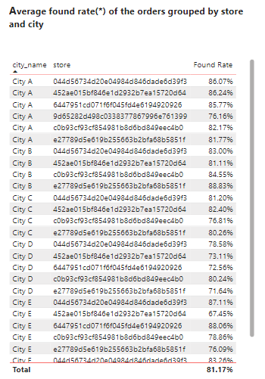
(3) Calculate the average found rate of the orders grouped by store and city
On dashboard
On report page

Slide 28
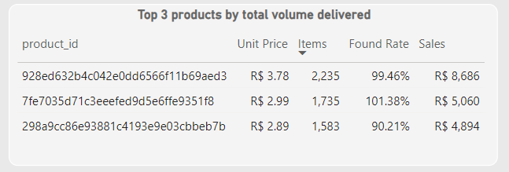
(4) Determine top 3 selling products_ids in total volume delivered to customer
On dashboard

Slide 29
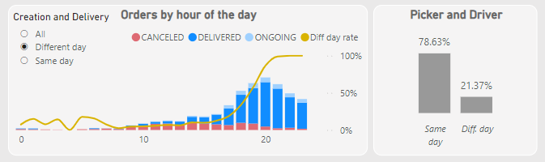
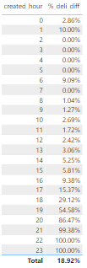
(5) Calculate the % of delivered orders that were created and delivered in different days, grouped by hour of creation
On dashboard
On report page

Slide 30
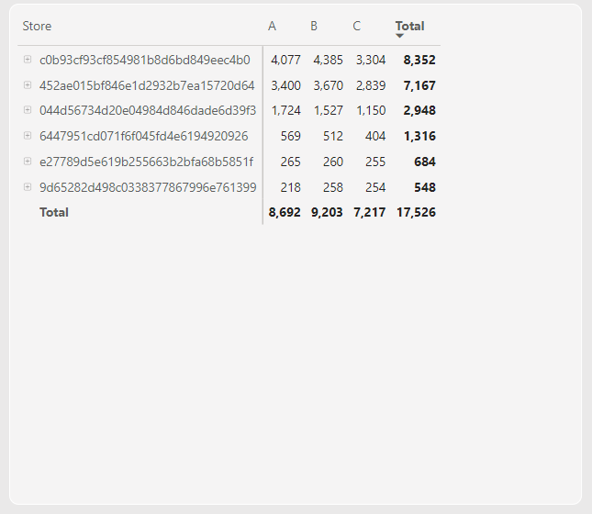
(6) Calculate how many products there are in each partition of the ABC Sales Curve grouped by store
On dashboard

Slide 31
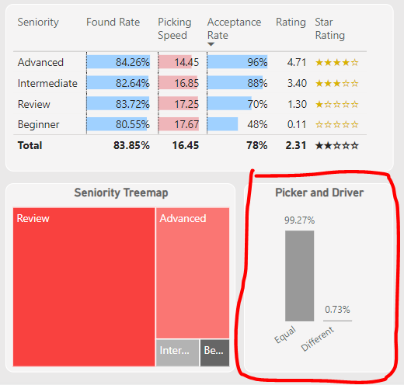
(7) Calculate the % of delivered orders in which the picker_id and driver_id are different
On dashboard

Slide 32
Google Sheets
Q6 - ABC classification

Slide 33
(6) Calculate how many products there are in each partition of the ABC Sales Curve grouped by store
Data modelling:
https://docs.google.com/spreadsheets/d/1Eo0yo_YeiuQkxnZJo-Xz80ulc88GWF6-RkvOGj49cRo/edit#gid=830354728

Slide 34
Thank you

